Slide 1


3 December, 2022
Sponsored and Supported by:

Slide 2


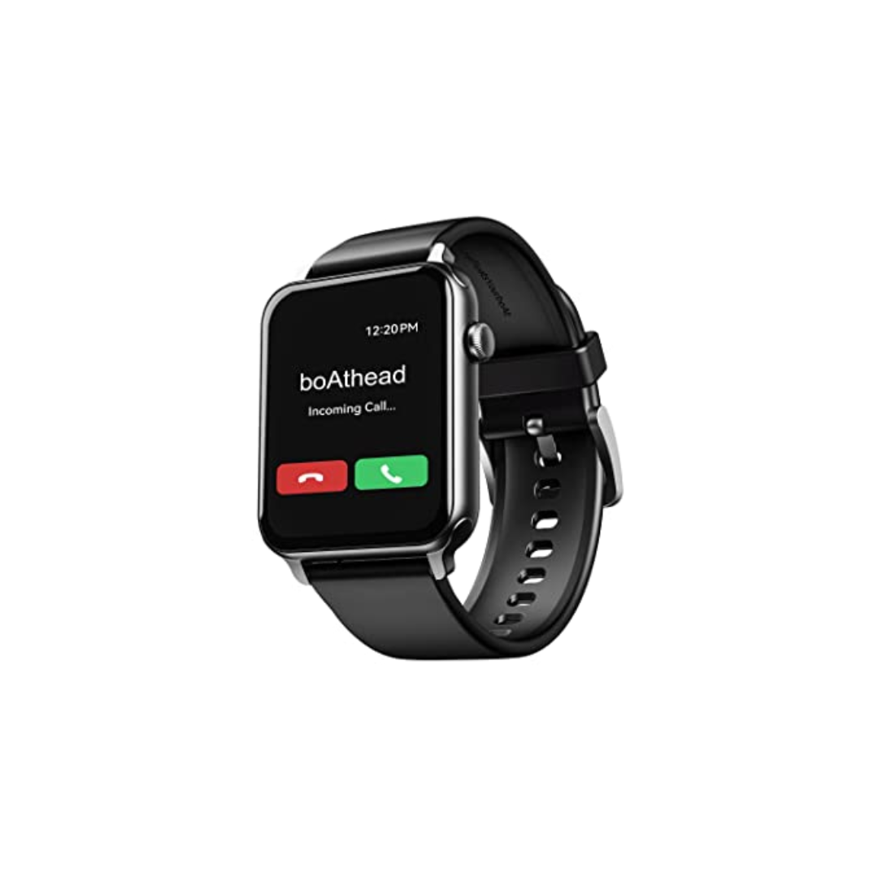
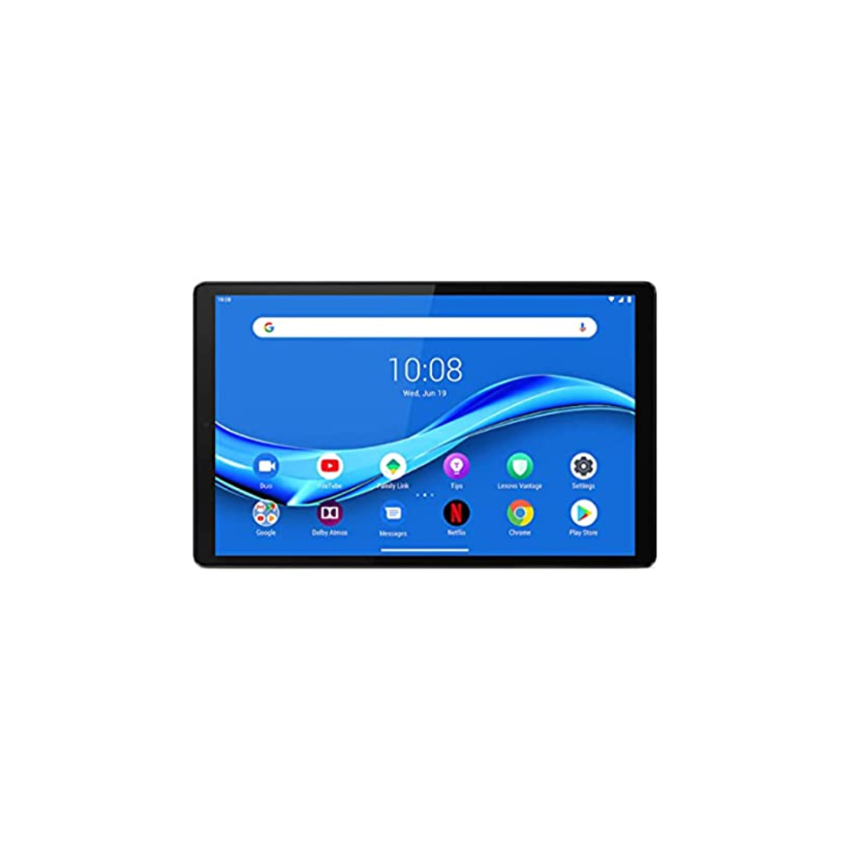


A One Day In Person Event
Win exiting prizes!
Lenovo M10 FHD Plus (2nd Gen)
JBL Tune 125TWS
boAt Blaze Smart Watch
Hands on sessions by experts and community leaders
Deep-dive into Microsoft 365 Services
Focus on:
Microsoft Teams
Power Platform
SharePoint
Cool Water Bottle
Developer Road Ahead

Slide 3




SUPPORT A CAUSE
“Giving is Receiving”
Support ‘Scope for Change’ to create more impact and touch the lives of more underprivileged students.

Slide 4

SPEAKERS PANEL
Session 6
Everything about SSO in Microsoft Teams
03:50 PM – 04:35 PM IST
Kunj Balkrishna Sangani
M365 consultant
LTIMindtree

Slide 5

SPEAKERS PANEL
Session No.
Session name
Session Time
Speaker 1
Speaker 2
Designation
Designation

Slide 6
SPEAKERS PANEL
Session No.
Session name
Session Time
Speaker Name
Designation

Slide 7
What we will learn
What is Single sign on(SSO)?
Why do we need SSO?
What is Teams SSO?
Microsoft Teams extensibility points
SSO in Teams Tab
SSO in Teams Bot
SSO in Teams Message extension

Slide 8

You know nothing, Developer

Slide 9
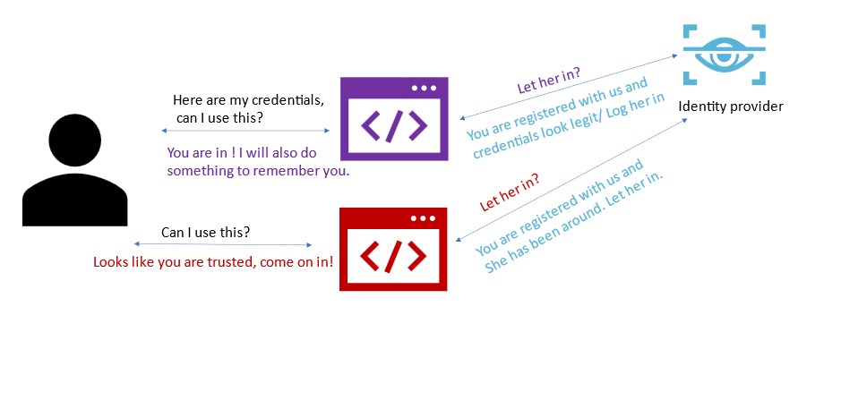
What is Single sign on(SSO)?
Single sign on allows users to log in once with their credentials and access services without having to re-enter them over and over.

Slide 10
Why do we need SSO?
Applications that are interconnected yet independent often require users to login separately to access and use them. This often disrupts the overall usability of an app and the satisfaction of users.
No pop-up, no prompts and no need to sign in again and again

Slide 11
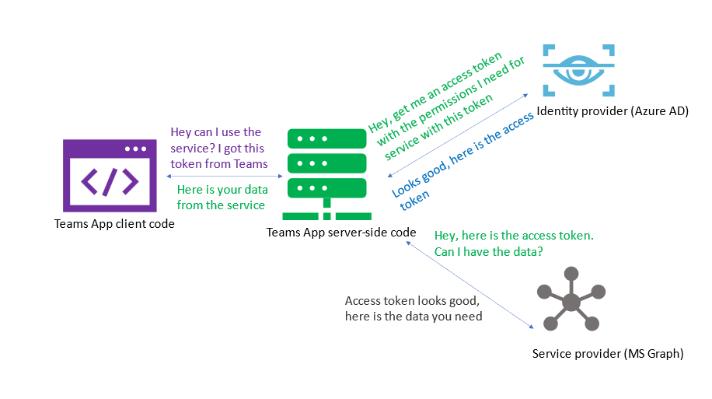
What is Teams SSO?
Teams SSO is when users can use a Microsoft Teams application with the same login they used when they signed into Microsoft Teams. The process is completely silent unless the application needs to ask the user to grant additional permissions.
Notes:
In the above diagram, we see how a SSO-enabled Teams tab functions.
The process is simple:
The client code uses Microsoft Teams JS SDK https://aka.ms/teams-js-sdk and gets an access token from Microsoft Teams. This token gives only basic user data information and is not usable to retrieve data from Microsoft Graph.
The client calls a web service, which is part of the Teams application. This web service calls Azure Active Directory to exchange the token from step one for an access token targeted to the Microsoft Graph, with the permission needed to retrieve the user’s profile.

Slide 12
Microsoft Teams extensibility points
Tabs
Bots
Message Extensions
Task Modules
Meeting Extensions
Cards

Slide 13
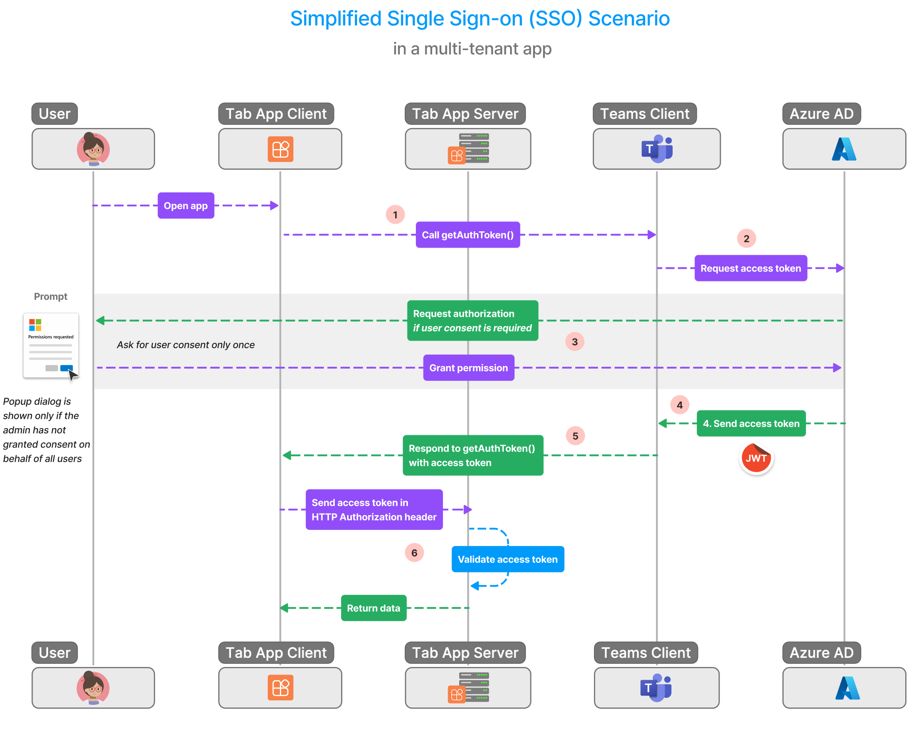
SSO for tab app

Slide 14
Demo
Demo

Slide 15
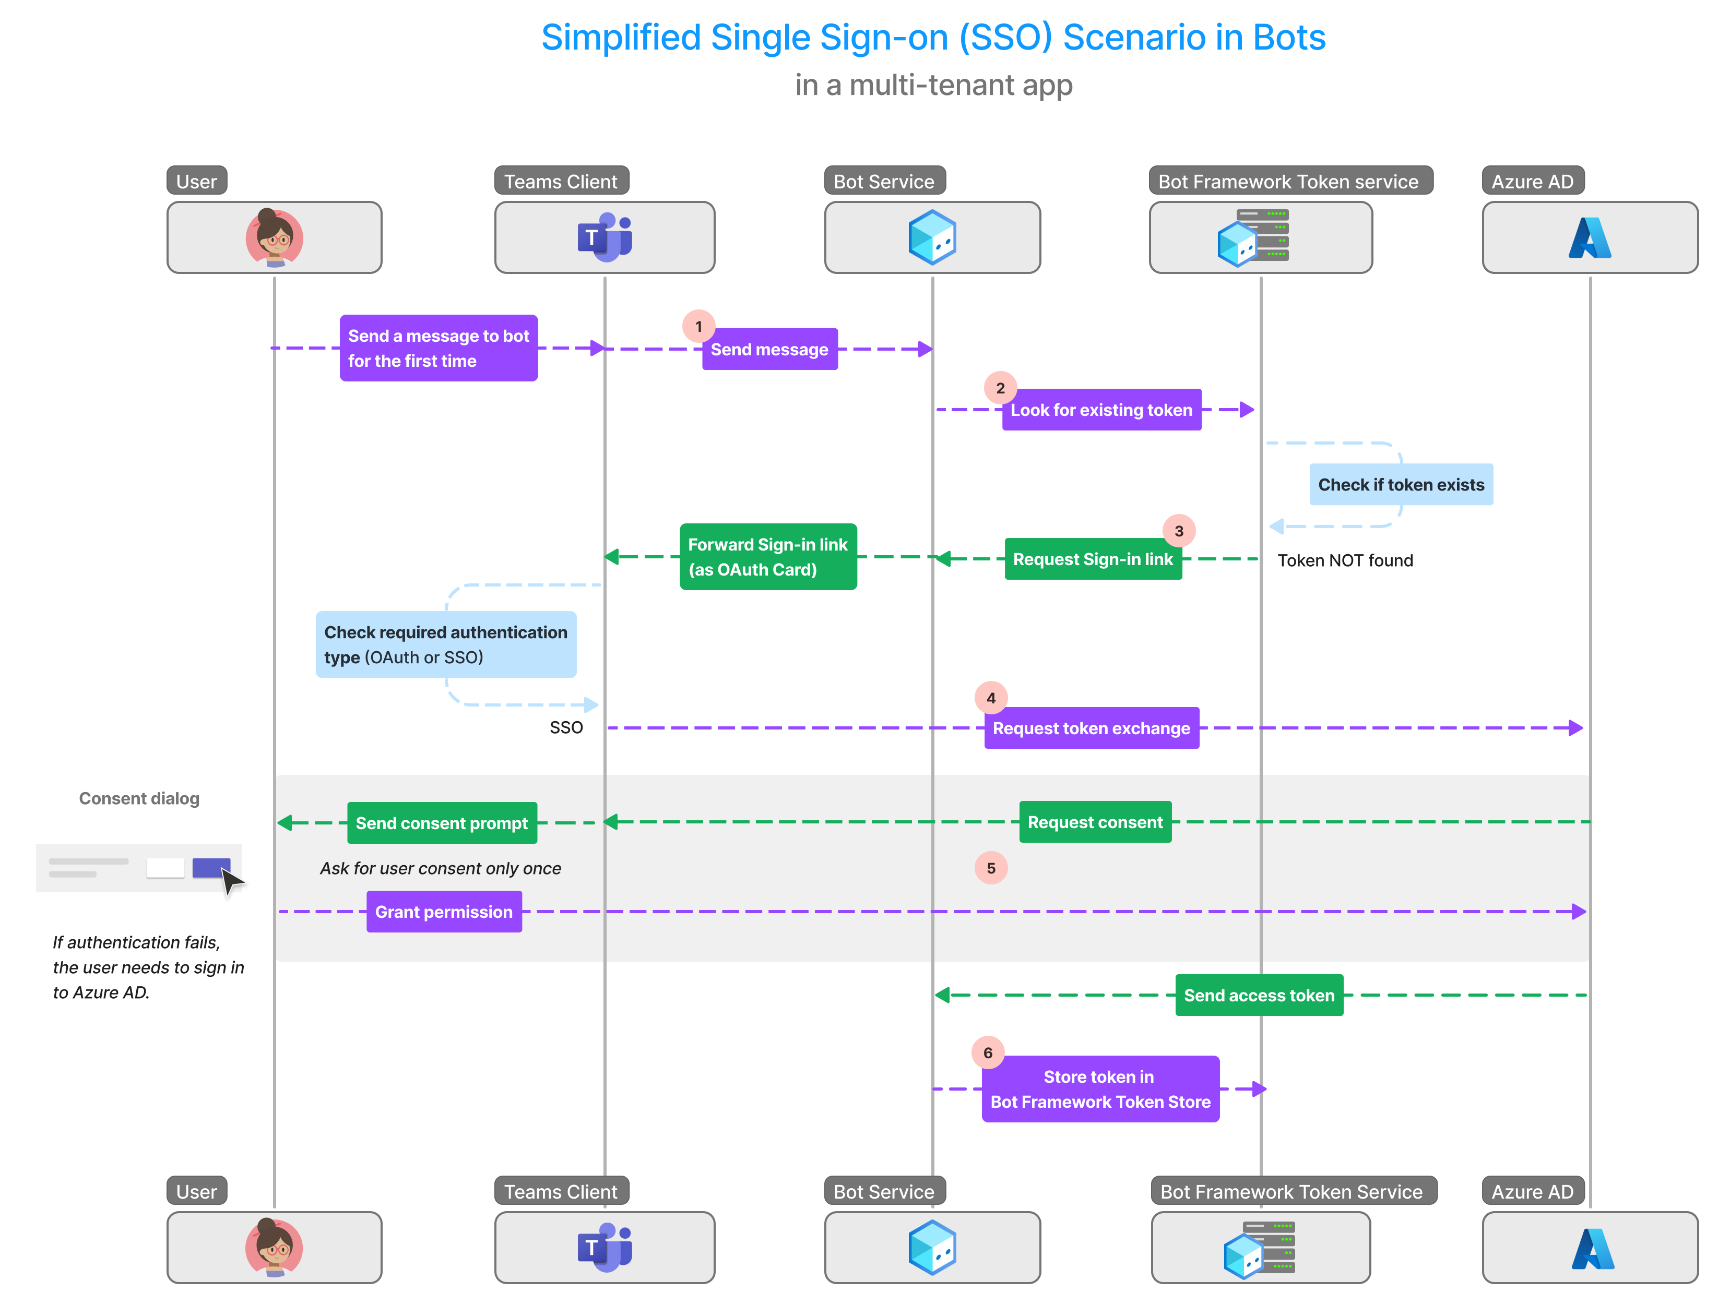
SSO for bot app

Slide 16
Demo
Demo

Slide 17






A Big Thank You to all the Sponsors!
Diamond:
Learning Partner:
Platinum:
Gold:

Slide 18

SPEAKERS PANEL
Next Session
Build Teams apps and extend across Microsoft 365
4:40PM – 5:25PM
Jenkins Ns

